Slide 1
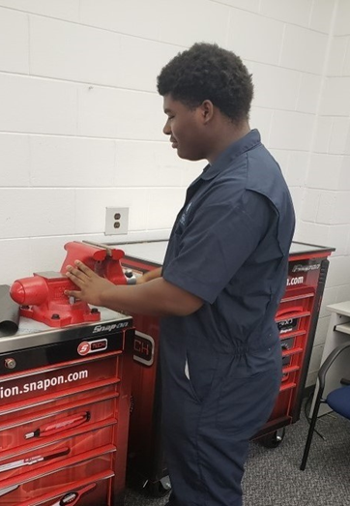
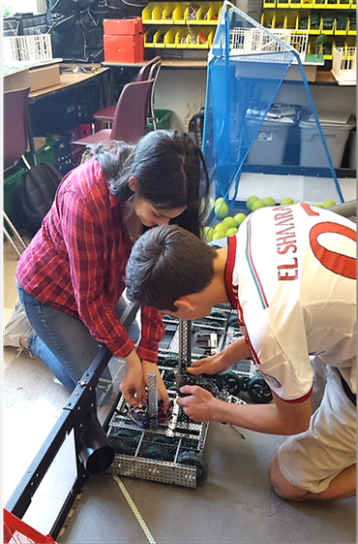
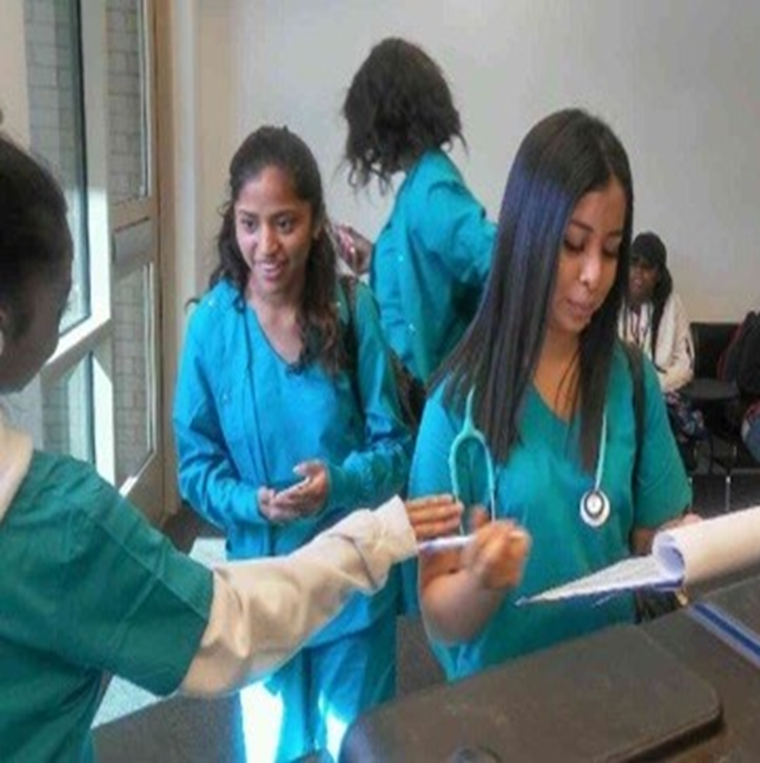
Virtual Open House
August 20, 2020
1 p.m.

Slide 2
Dr. Tasharah Wilson, Principal

Slide 3
Early Childhood Education Pathway
Presenter: Pamela F. Harris
3

Slide 4
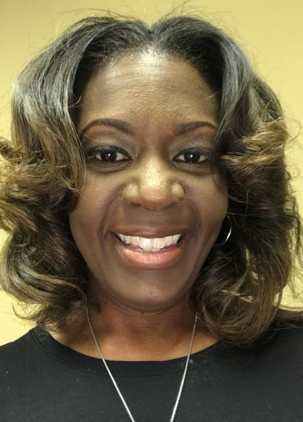
Welcome to Early Childhood Education. I’m excited to be your teacher!
My name Pamela Harris and I am a Georgia native. I have more than 20 years of experience in early childhood education serving in roles from preschool teacher to family resource center director. I have bachelor’s degree in early childhood education, master’s degree in education and a family development credential.
I am married, and I have two biological children, two bonus children and seven grandchildren.
I chose the field of early childhood education because I love working with children and families! I am very passionate about utilizing education, intervention and advocacy as the catalysts to empowering healthy families and communities to thrive.

Slide 5
Praying and Meditating
Facilitating Classes
Reading /Journaling
Baking biscuits with my grands
Relaxing with my family
Listening to old school music
Black Walnut Ice Cream
Double Bubble Bubblegum
Red Velvet Cake
The Chi
HGTV

Slide 6
Exciting Facts Early Childhood Education Pathway at ACCA!
Preschool, kindergarten and elementary school teachers
play a vital role in the development of children.
Most early childhood education teachers work a 10‐month school
year with a 2‐month vacation during the summer.
Teachers have the privilege of working with students from varied
ethnic, racial and religious backgrounds.
Annual teaching salaries median salary range: $27,900 (Teacher Assistants) to
$59,420.
https://www.onetonline.org/link/summary/39-9011.00
Bureau of Labor Statistics, U.S. Department of Labor, Occupational Outlook Handbook, Teacher Assistants, on the Internet at https://www.bls.gov/ooh/education-training-and-library/teacher-assistants.htm (visited August 11, 2020).

Slide 7
Teaching: A Georgia Hot Career!
When thinking about your future, researching careers in teaching that are in demand or in an up-and-coming field is a great place to start.
Georgia's HOT Careers to 2020 are occupations identified with fast job growth, above average wages and at least 100 expected annual job openings. They are organized by the required education level and include the types of skills needed and what type of work activities are involved.
Georgia Pre-school and Pre‐K teachers must meet current credential requirements outlined in The Georgia Department of Early Learning Guidelines. The state of Georgia require you to have education beyond high school to become a licensed teacher which often leads to increased income and opportunities.
Source: Georgia Department of Labor

Slide 8
Atlanta College and Career Counseling Team

Slide 9
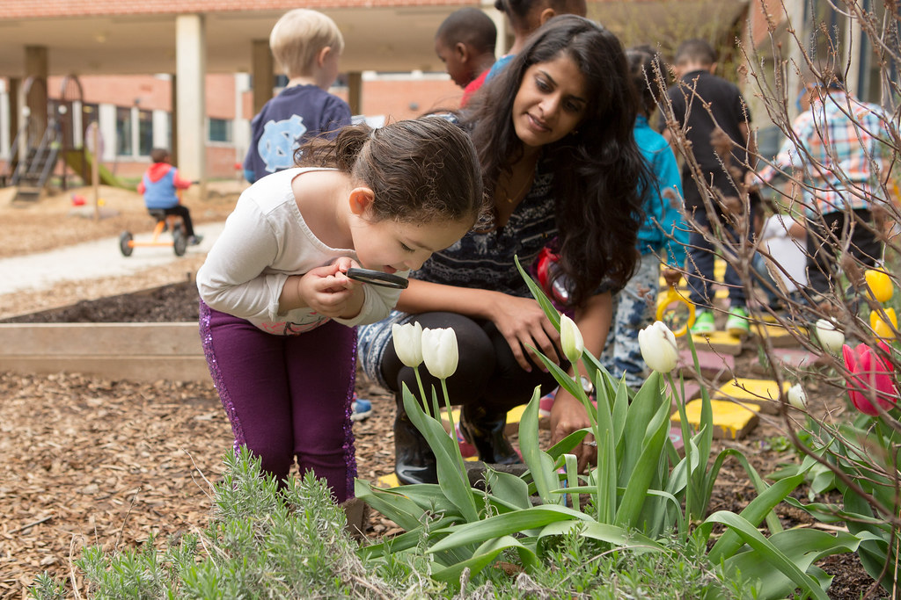
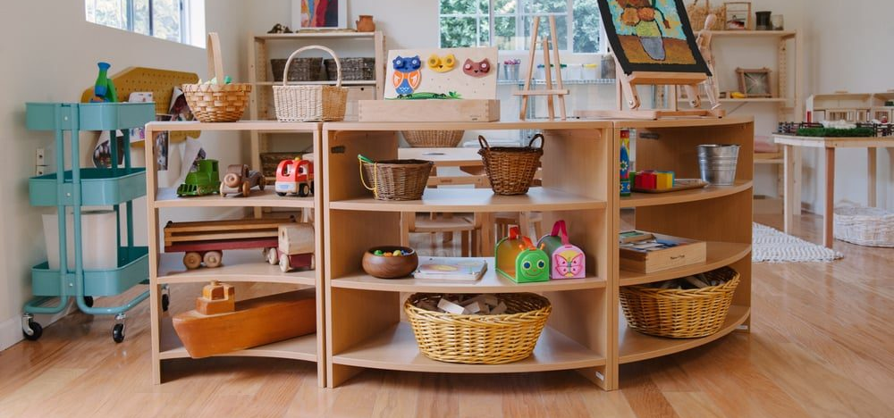
Let’s take a look at some of the awesome pathway experiences planned just for you!

Slide 10
Exploration of Pathway Examine early childhood care and education 21 century teaching and learning Create and design a portfolio documenting your experiences Participate in classroom lab and technical skills practice Plan fun lessons activities to teach young learners Virtual Fieldtrips Guest Speakers Singing, dancing, painting, problem-solving, investigating, laughing and playing! .

Slide 11
Instructional Expectations

Slide 12
What Burning Questions Do You Have?

Slide 13
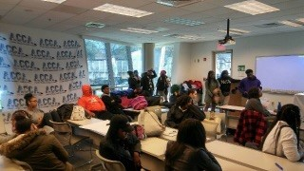
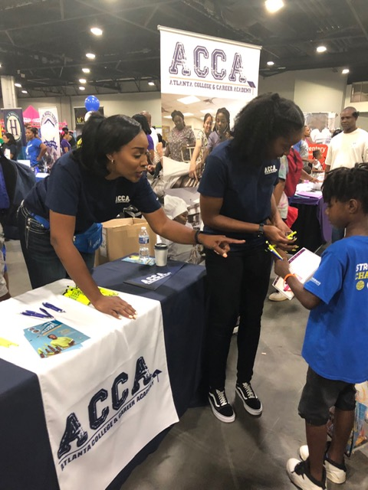
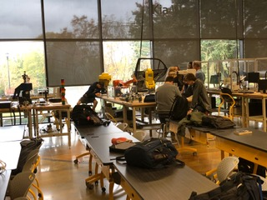
13

Slide 14
Test Run!
Google Classroom Codes:
Morning Class: dgsfghy
Afternoon Class: xhpia7v
pamela.harris@apsk12.org

